Slide 1
Parallel & Distributed Computing
Lecture 2
Dr. Faisal Bin Ubaid

Slide 2
Advantages of cloud computing?

Slide 3
Advantages of cloud computing
Cost
Cloud computing eliminates the capital expense of buying hardware and software and setting up and running on-site datacenters—the racks of servers, the round-the-clock electricity for power and cooling, and the IT experts for managing the infrastructure.

Slide 4
Speed
Most cloud computing services are provided self service and on demand, so even vast amounts of computing resources can be provisioned in minutes, typically with just a few mouse clicks, giving businesses a lot of flexibility and taking the pressure off capacity planning.
Global scale
The benefits of cloud computing services include the ability to scale elastically. That means delivering the right amount of IT resources—for example, more or less computing power, storage, bandwidth—right when they’re needed, and from the right geographic location.

Slide 5
Productivity
On-site datacenters typically require a lot of “racking and stacking”—hardware setup, software patching, and other time-consuming IT management chores. Cloud computing removes the need for many of these tasks, so IT teams can spend time on achieving more important business goals.
Reliability
Cloud computing makes data backup, disaster recovery, and business continuity easier and less expensive because data can be mirrored at multiple redundant sites on the cloud provider’s network.

Slide 6
Disadvantages of cloud computing?

Slide 7
Disadvantages of cloud computing
Cloud computing is not necessarily cheaper than other forms of computing, just as renting is not always cheaper than buying in the long term
If an application has a regular and predictable requirement for computing services it may be more economical to provide that service in-house
Some companies may be reluctant to host sensitive data in a service that is also used by rivals
And of course, you can only access your applications if you have an internet connection.

Slide 8
Even the largest and most technologically advanced companies can be vulnerable to being hacked.
Case in point is the pioneering electric car company, Tesla, owned by tech billionaire Elon Musk.
An unidentified hacker or hackers broke into a Tesla-owned Amazon cloud account and used it to “mine” cryptocurrency , Monero
Who knows when; who knows for how long!

Slide 9
Capital One Data Breach (2019)
What Happened: A former employee of Amazon Web Services (AWS) exploited a misconfigured firewall to access sensitive data from Capital One, which was hosted on AWS. The breach affected over 100 million customers, exposing personal and financial information.
Key Concern: Although the cloud provider (AWS) wasn't directly at fault, the breach showcased how misconfigurations and insider threats in shared environments can lead to significant data exposure.

Slide 10
Microsoft Azure Cosmos DB Vulnerability (2021)
What Happened: Researchers discovered the "ChaosDB" vulnerability in Microsoft Azure's Cosmos DB, which allowed unauthorized access to other users’ databases. This flaw could have been exploited to access sensitive data from competing businesses.
Key Concern: The risk of data exposure due to vulnerabilities in the shared architecture of cloud services.

Slide 11
Geography and Cloud Computing
Geopolitics is forcing significant changes on cloud-computing users and vendors
Firstly, there is the issue of latency: if the application is coming from a data center on the other side of the planet, or on the other side of a congested network, then you might find it sluggish compared to a local connection
Secondly, there is the issue of Data sovereignty
Data sovereignty is the concept that information which has been converted and stored in binary digital form is subject to the laws of the country in which it is located

Slide 12
Many companies, particularly in Europe, have to worry about where their data is being processed and stored
European companies are worried that, for example, if their customer data is being stored in data centers in the US or (owned by US companies), it could be accessed by US law enforcement
As a result, the big cloud vendors have been building out a regional data center network so that organizations can keep their data in their own region.

Slide 13
Cloud-computing region? availability zone?
Cloud-computing services are operated from giant datacenters around the world
Cloud service vendors often divides these datacenters by 'regions' and 'availability zones‘
Each region is a separate geographic area, like EU (London) or US West (Oregon), which then further subdivides into what it calls availability zones (AZs)

Slide 14
Cloud-computing region? availability zone?
An AZ is composed of one or more datacenters that are far enough apart that in theory a single disaster won't take both offline, but close enough together for business continuity applications that require rapid failover
Each AZ has multiple internet connections and power connections to multiple grids

Slide 15
Cloud computing model NIST

Slide 16
Cloud computing model NIST
According to the National Institute of Standards and Technologies (NIST)
cloud computing is a model for enabling ubiquitous, convenient, on-demand network access to a shared pool of configurable computing resources (networks, servers, storage, applications, and services) that can be rapidly provisioned and released with minimal management effort or service provider interaction

Slide 17
This cloud model is composed of five essential characteristics:
Broad network access
On-demand self-service
Resource pooling
Rapid elasticity
Measured Service

Slide 18
Broad network access: Cloud services are accessible over the network and can be reached using standard mechanisms. This characteristic emphasizes that cloud resources are available over the internet and can be accessed from a variety of devices, including laptops, tablets, and smartphones. This broad network access supports the flexibility and mobility of users, allowing them to work from virtually anywhere
On-demand self-service: On-demand self-service means that users can provision computing resources such as server time and network storage automatically without requiring human interaction with each service provider.

Slide 19
Resource pooling: Service multiple customers from the same physical resources, by securely separating the resources on logical level. To the consumer, the capabilities available for provisioning often appear to be unlimited and can be appropriated in any quantity at any time
Rapid elasticity: Resources are provisioned and released on-demand and/or automated based on triggers or parameters. This will make sure your application will have exactly the capacity it needs at any point of time.
Measured service: Resource usage are monitored, measured, and reported (billed) transparently based on utilization. In short, pay per use.

Slide 20
Cloud Enabling Technologies

Slide 21
Cloud Enabling Technologies
Broadband networks and internet architecture
Virtualization technology
SOA
Web Services , Web 2.0,3.0
Multitenant technology

Slide 22
Broadband networks & Internet architecture
All cloud’s resources must be connected to a network
This inevitable requirement forms an inherent dependency on internetworking.
Internetworks, or the Internet, allow for the remote provisioning of IT resources and are directly supportive of ubiquitous network access.

Slide 23
Internet Service Providers (ISPs)
Established and deployed by ISPs, the Internet's largest backbone networks are strategically interconnected by core routers that connect the world's multinational networks.

Slide 24
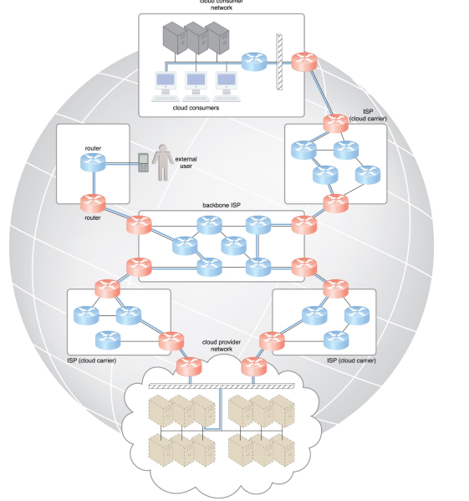

Slide 25
Cloud Consumer Network: At the top, there's a network representing cloud consumers, which includes multiple servers and devices connected via routers. This part of the network serves the end-users who consume cloud services.
External User: A single external user is shown connecting to the network, probably representing a remote user accessing cloud services.
Backbone ISP: The central part of the diagram shows a backbone Internet Service Provider (ISP) that connects various parts of the network. This backbone ISP facilitates data transmission across different networks, providing the necessary bandwidth.
ISP (Cloud Carrier): There are multiple ISPs labeled as cloud carriers. These ISPs are responsible for routing traffic between the cloud provider network and the cloud consumers, as well as the backbone ISP.
Cloud Provider Network: At the bottom, there's a cloud provider network, symbolized by a cloud with multiple servers (depicted as cubes or racks). This network hosts the cloud services and connects to the ISPs.

Slide 26
Data Flow in the Cloud Network From Cloud Consumers to Cloud Services
Initial Request: A cloud consumer initiates a request (e.g., accessing a web application hosted in the cloud).
Routing Through ISP: The request is routed through the cloud consumer’s network and is passed on to the nearest ISP (Cloud Carrier).
Backbone ISP Transmission: The cloud carrier transmits the request via the backbone ISP, which may pass through multiple routers and ISPs depending on the network path.
Cloud Provider Network Reception: The request finally reaches the cloud provider's network, where it is processed, and the requested service or data is delivered back to the consumer through the same path in reverse.

Slide 27
Cont.
Worldwide connectivity is enabled through a hierarchical topology composed of Tiers 1, 2, and 3
The core Tier 1 is made of large-scale, international cloud providers that oversee massive interconnected global networks, which are connected to Tier 2's large regional providers
The interconnected ISPs of Tier 2 connect with Tier 1 providers, as well as the local ISPs of Tier 3.

Slide 28
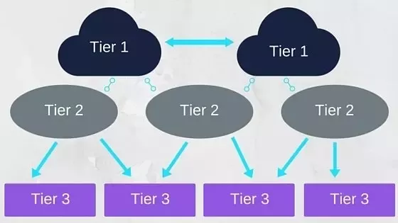
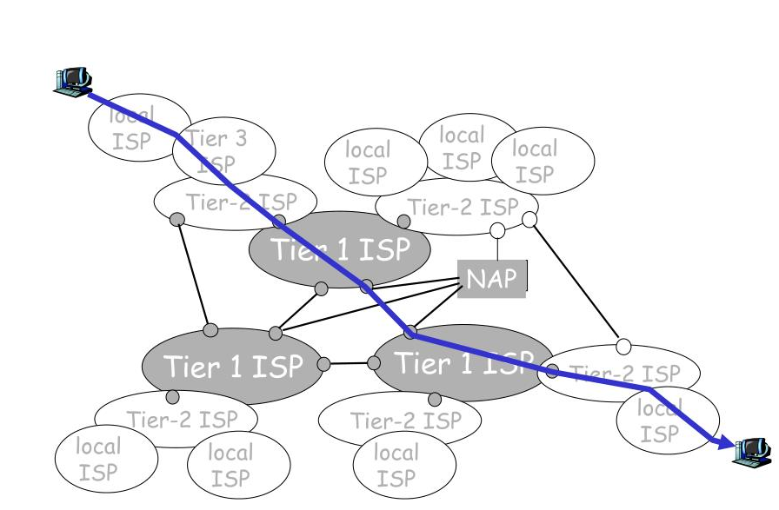

Slide 29
Virtualization
Virtualization is a process of converting a physical IT resource into a virtual IT resource
Server
Virtual server ↔ virtual machine
Storage
Network

Slide 30
SOA?

Slide 31
Case Study
Online Parking Ticket
Maps, Payments, User login & Authentication
Maps - Google Maps
Payments -Existing payment gateway
User Authentication – Facebook Gmail
The building-block services might employ pre-existing components that are reused, and can also be updated or replaced without affecting the functionality or integrity of other independent services

Slide 32
SOA: Service Oriented Architecture
SOA is a software design approach in which applications are built as a collection of loosely coupled, reusable services
Each service performs a specific business function and communicates with other services over a network using standardized interfaces such as SOAP, or REST APIs

Slide 33
Key features of SOA
Loose coupling: Services are independent and can be changed without affecting others
Reusability: The same service can be reused across multiple applications
Interoperability: Services can communicate regardless of programming language or platform
Standard interfaces: Services expose well-defined contracts

Slide 34
Web services
Web services are the prominent technology for implementing SOA systems and applications
A Web service is a self-describing, self-contained software module available via a network, such as the Internet, which completes tasks, solves problems, or conducts transactions on behalf of a user or application.
Self-describing: It knows what functions it can perform and what inputs it requires to produce its outputs.
It can also describe its non-functional properties like cost of invoking the service, the geographical areas the Web service covers etc.
It can describe this to potential users & other Web services

Slide 35
Web and Cloud Computing
The Web is the primary interface through which cloud computing delivers its services.
Web 1.0 (Static Web): Early web, primarily composed of static HTML pages with little interactivity
Web 2.0 is characterized by dynamic content, user-generated content, and interactive experiences, all of which are heavily reliant on cloud computing for scalability, storage, and processing power.
Platforms like YouTube, Facebook, and Instagram rely on cloud infrastructure to store and serve vast amounts of user-generated content. The cloud provides the scalable storage and computing resources needed to handle millions of users simultaneously.

Slide 36
Web and Cloud Computing …
Web 3.0 (often referred to as the Semantic Web) envisions a more intelligent, decentralized, and user-centric internet, where machines can understand and process information in a human-like manner. Web 3.0 also integrates emerging technologies like blockchain, AI, and decentralized applications (dApps).

Slide 37
Multitenant technology
Definition: Multitenancy is an architecture in which a single instance of a software application serves multiple tenants (users or user groups). Each tenant's data and configurations are isolated, despite being hosted on the same physical or virtual server.
Analogy: Think of a multitenant system as an apartment building. Each tenant (user) has their own apartment (data and configurations), but they share common infrastructure like elevators, hallways, and utilities (the application and underlying hardware).

Slide 38
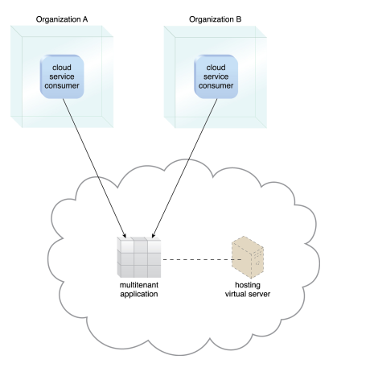
A simple example

